Slide 1
CSD310 Database Development and Use
Bacchus Winery Case Study

Slide 2

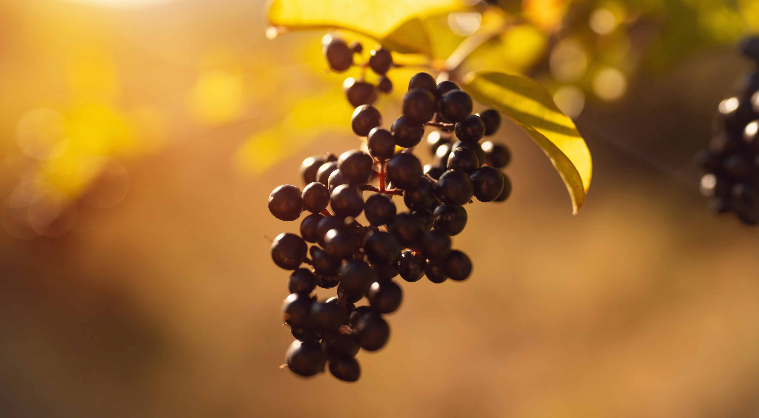
Ashley Landin
Cody Ferre
Deandra Ash
Irene Carrillo Jaramillo
Samuel Segars
Bacchus Case Study Project Bacchus Case Study Project Members

Slide 3
Case Study: Bacchus Winery
Company History
The company was inherited by Stan and Davis Bacchus from their father after his retirement.
They are currently hoping to implement new business methods to further the company’s success
Business Practices
Bacchus Winery grows grapes for their Merlot, Cabernet, Chablis, and Chardonnay.
They have suppliers for the following products: bottles and corks, labels and boxes, and vats and tubing. Each shipment comes every month.
Stan and Davis keep track of the supply inventory.
Maria is the one in charge of distribution.
Case Study Questions
Are all suppliers delivering on time?
Is there a large gap between expected delivery and actual delivery?
The wine distribution, are all wines selling as they thought?
Is one wine not selling?
Which distributor carries which wine?
During the last four quarters, how many hours did each employee work?

Slide 4
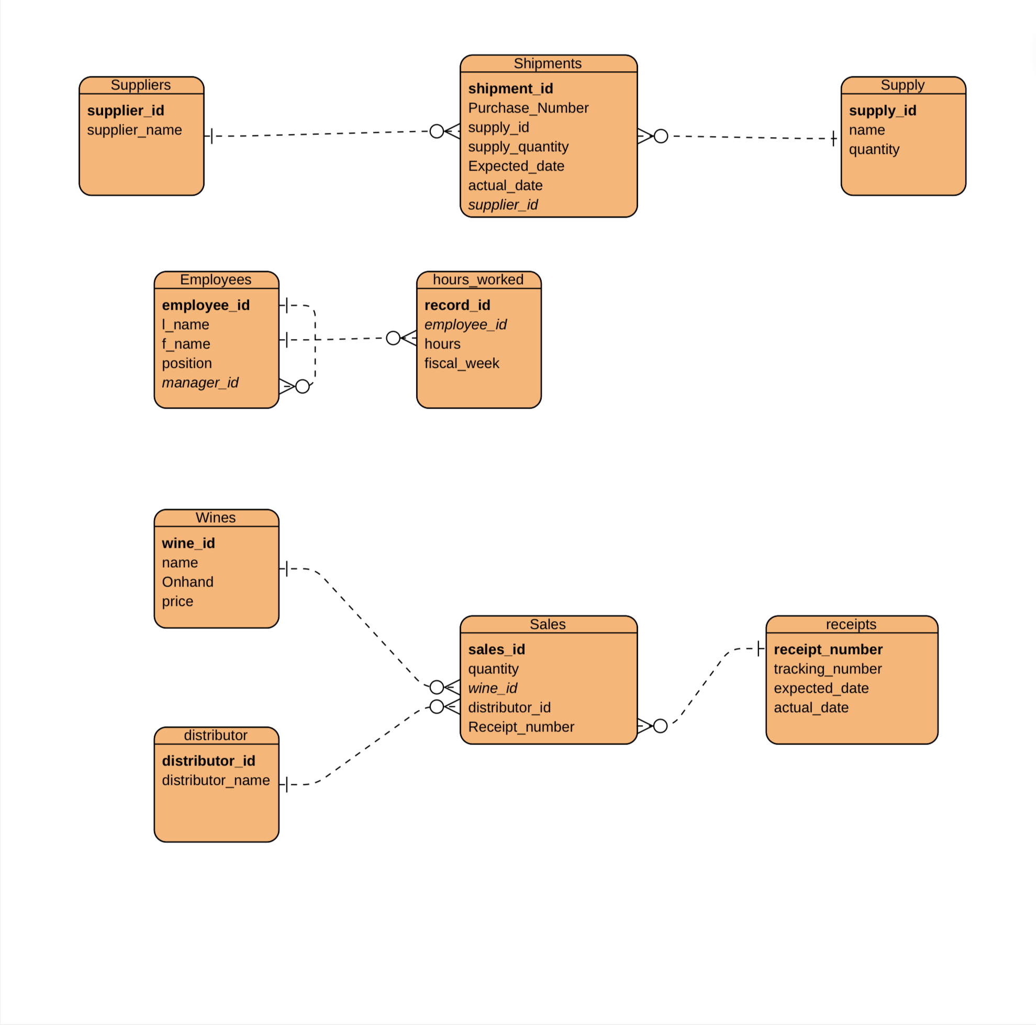

Slide 5
Supplier/Shipment Report Description
The information needed for the report is the time stamp for deliveries from each supplier and the comparison between expected and actual delivery time.
Elements of the Report
Supplier List
Names and contact information of all suppliers.
Delivery time analysis
A month-by-month breakdown of expected delivery times versus actual delivery times for each supplier.
Highlight any significant delays or discrepancies.
Key areas of focus are:
Identify suppliers with consistently delayed deliveries.
Provide recommendations for improvement.

Slide 6
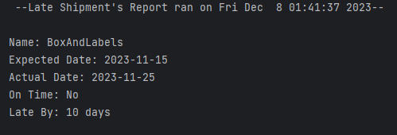
Report Results

Slide 7
Employee Hours Report Description
The information needed for the report is the hours worked by each employee each quarter.
Elements of the report:
Names and roles of all employees.
Breakdown of hours worked by each employee for each quarter.
Identify any patterns or trends in employee time.
Total hours worked
Summarize the total hours worked by each employee over the entire year.

Slide 8
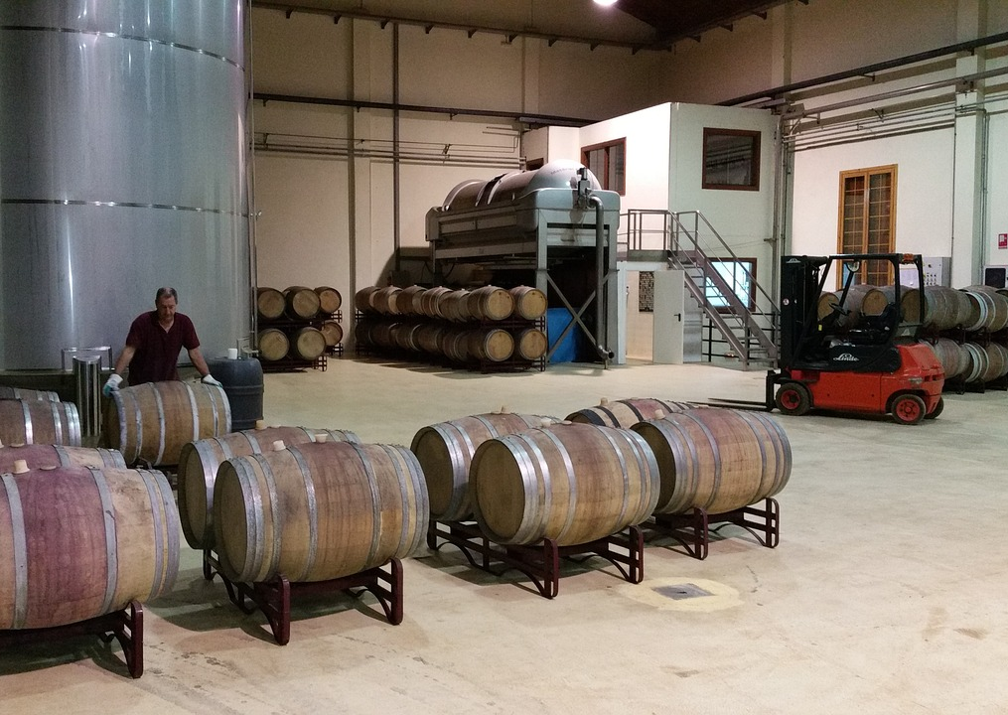
Employee Roles
Janet Collins- Finances and Payroll
Roz Murphy - Marketing
Bob Ulrich - Marketing Assistant
Maria Constanza - Distribution Manager
Henry Doyle - Production Line Manager
Production consists of a 20 Member crew.

Slide 9
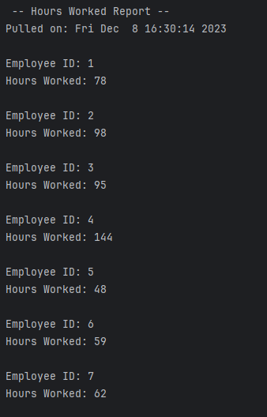
Report Results

Slide 10
Wine Distribution Report Description
The information needed for the report is the sales performance of each wine. Also, distribution details for each wine.
Elements of the Report:
Wine sales
Sales data for each wine over the last four quarters.
Identify top-selling and low-performing wines.
Distributor information
List of all distributors.
Assignment of each wine to specific distributors.
Highlight wines that are not meeting sales expectations.

Slide 11
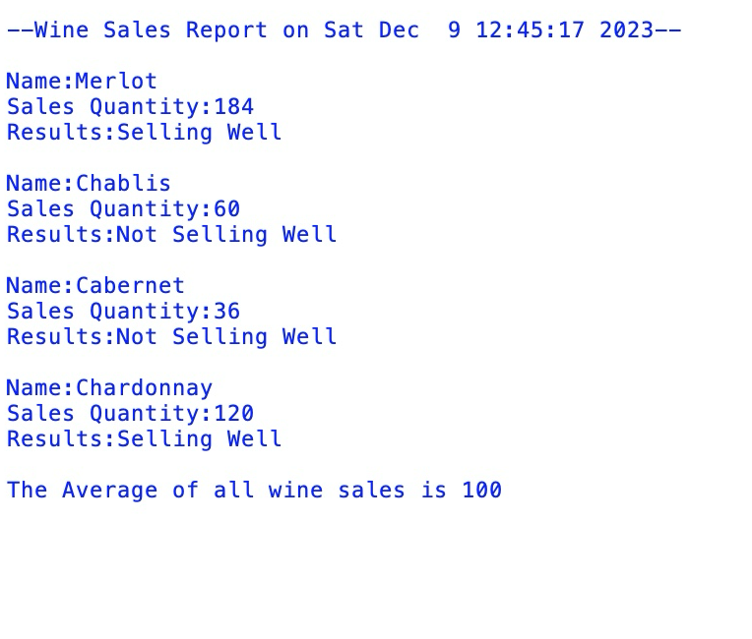
Report Results

Slide 12
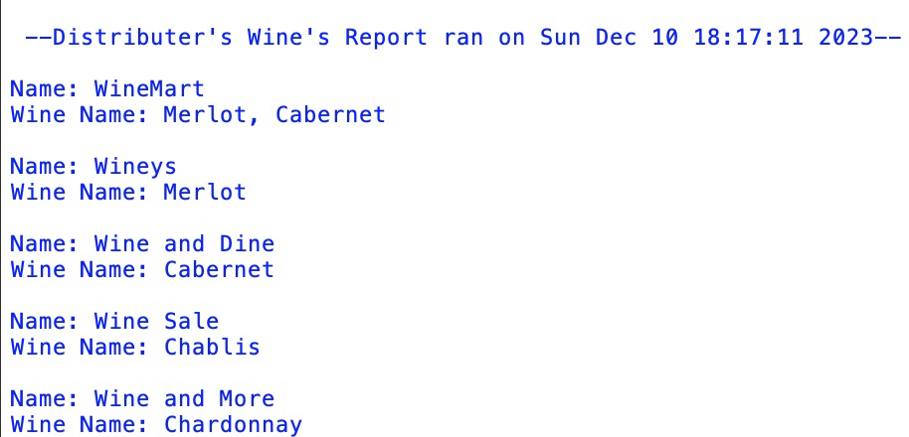
Report Results

Slide 13
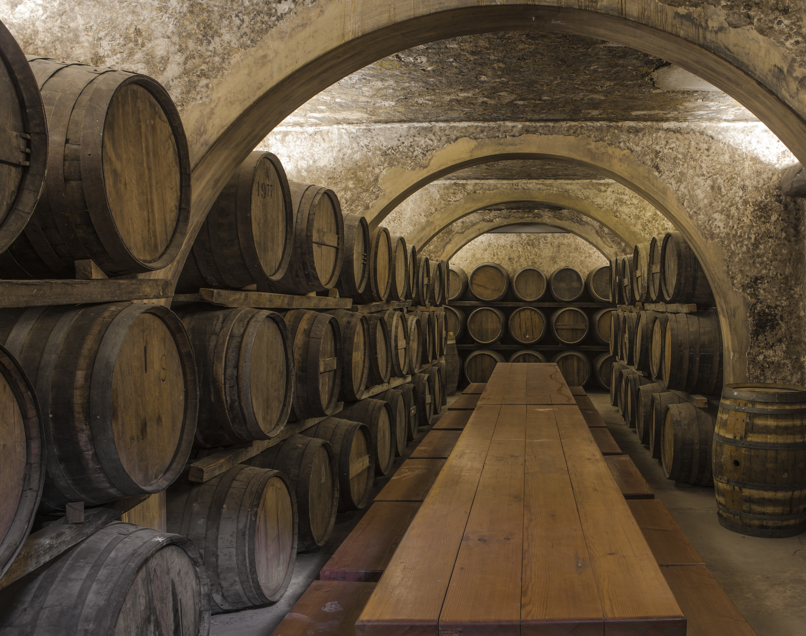
Assumptions
While interpreting the case study to propose design ideas, several assumptions were made based on the information provided. The case implies Stan and Davis's desire to modernize the winery's operations and improve business methods. This assumption leads to suggestions for adopting technology-driven solutions and updated processes. With this assumption in mind, we wanted to make sure a modernized design was put into place, as well as a minimalistic look. Incorporating supply chain software would offer real-time tracking of orders and shipments. Time tracking applications would prove to be helpful for accuracy.

Slide 14
